Slide 1
SELENIUM WEB AUTOMATION TESTING (JAVASCRIPT)
Presented by: Group - 5
(Software Engineering)

Slide 2
Team Members
Phyo Than Thar Kyaw
Yamin Eaindray
4SE-1016
4SE-1163
Myint Theingi Tun
Ei Thinzar
4SE-1187
4SE-1147
Khant Hay Thi Tun
Nadi Lin
4SE-1166
4SE-1232

Slide 3
TABLE OF CONTENTS
01
02
03
04
05
06
What is Selenium?
Web Automation
Types of Selenium Testing
Why Selenium for our test?
Why JavaScript?
Tool Requirements

Slide 4
01
What is Selenium?

Slide 5
Selenium is a free (open-source) automated testing framework used to validate web applications across different browsers and platforms like Chrome, Firefox, Safari, Edge and Opera.

Slide 6
Benefits of using Selenium Testing
Selenium is a cost-effective solution for web automation testing.
It supports a wide range of Programming Languages, including Java, Python, PHP, C#, Ruby, and JavaScript. This flexibility allows testers to work with their prefered programming Languages.
Selenium can be used on multiple Operating Systems, including Window, macOS, and Linux.
Parallel testing with Selenium involves executing multiple test cases simultaneously to reduce the overall testing time.

Slide 7
02
Types of Selenium Testing

Slide 8
To validate if the website functions according to the specific requirements.
Check specific functionalities, simulating UI like clicking, typing and navigation.
Functional Testing
To ensure that new changes have not impacted the existing functionalities.
Crucial for continuous development environments.
Regression Testing
To validate the functions of website.
Check the health of website after a new build or update goes live.
Smoke
Testing

Slide 9
To test across multiple browsers
Ensuring the website’s behavior and appearance are consistent.
Cross Browser
Testing
By giving a random input to the system.
It could be a click, scroll or dummy text string.
Monkey
Testing
Test UI components like buttons, text field, and menus.
Functional and responsive.
Verifies usability of the websites.
UI
Testing

Slide 10
03
Web Automation

Slide 11
What is Web Automation?
Web automation refers to the process of automating repetitive tasks performed on a website or web application.

Slide 12
Benefits of Web Automation
Increased Efficiency
Improved Accuracy
Automating tasks save time and effort
Minimizes Human errors
Scalability
Enhanced Productivity
Allows for handling large volumes of data
Enables employees to focus on higher-value activities

Slide 13
Tools and Technologies for Web Automation
Selenium
Puppeteer
UiPath
Python

Slide 14
04
Why use Selenium for Automation Testing?

Slide 15
Major Reasons for choosing Selenium
Open Source
Multilingual Support
Cost effective solution for web automation testing
Supports wide range of programming languages
Cross Platform Compatibility
Cross Browser Testing
Can be used on multiple operating system such as Windows,macOs and Linux
Support automated testing on variety of web browsers

Slide 16
05
Why we choose JavaScript?

Slide 17
Reasons for using Selenium with JavaScript
2. Easy Testing with WebDriverIO
4. Works Everywhere
5. Familiar for Developers
Handles Modern Website Stuff
3. Lots of Helpful Tools

Slide 18
06
Tool Requirements

Slide 19
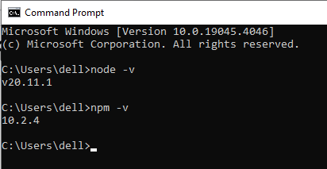

“Project Setup for Selenium Webdriver with JavaScript”
Prerequisites:
Node JS and NPM install
IDE of your choice:
We will be using Visual Studio Code as IDE

Slide 20
“Project Setup for Selenium Webdriver with JavaScript(Cont’d)”
Create a project folder in the desired location in your system. Open the folder in your IDE.
Step 1
Initialize the project in this folder. Open the IDE terminal and navigate to the project location. Run the following command:
npm init -y
Step 2
Now, install the project dependencies. We need to install Selenium WebDriver and browser drivers:
npm install --save selenium-webdriver chromedriver geckodriver
Step 3

Slide 21
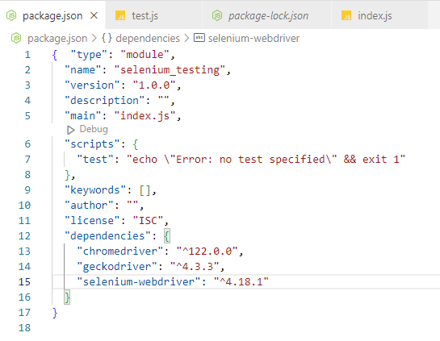
“Project Setup for Selenium Webdriver with JavaScript(Cont’d)”
Once you run the command, you’ll notice that a “node_modules” folder is created in the project root. The folder contains all the dependencies. Also, package.json will be updated with these dependencies.
Step 4

Slide 22

Let’s Test “Selenium”

